Slide 1
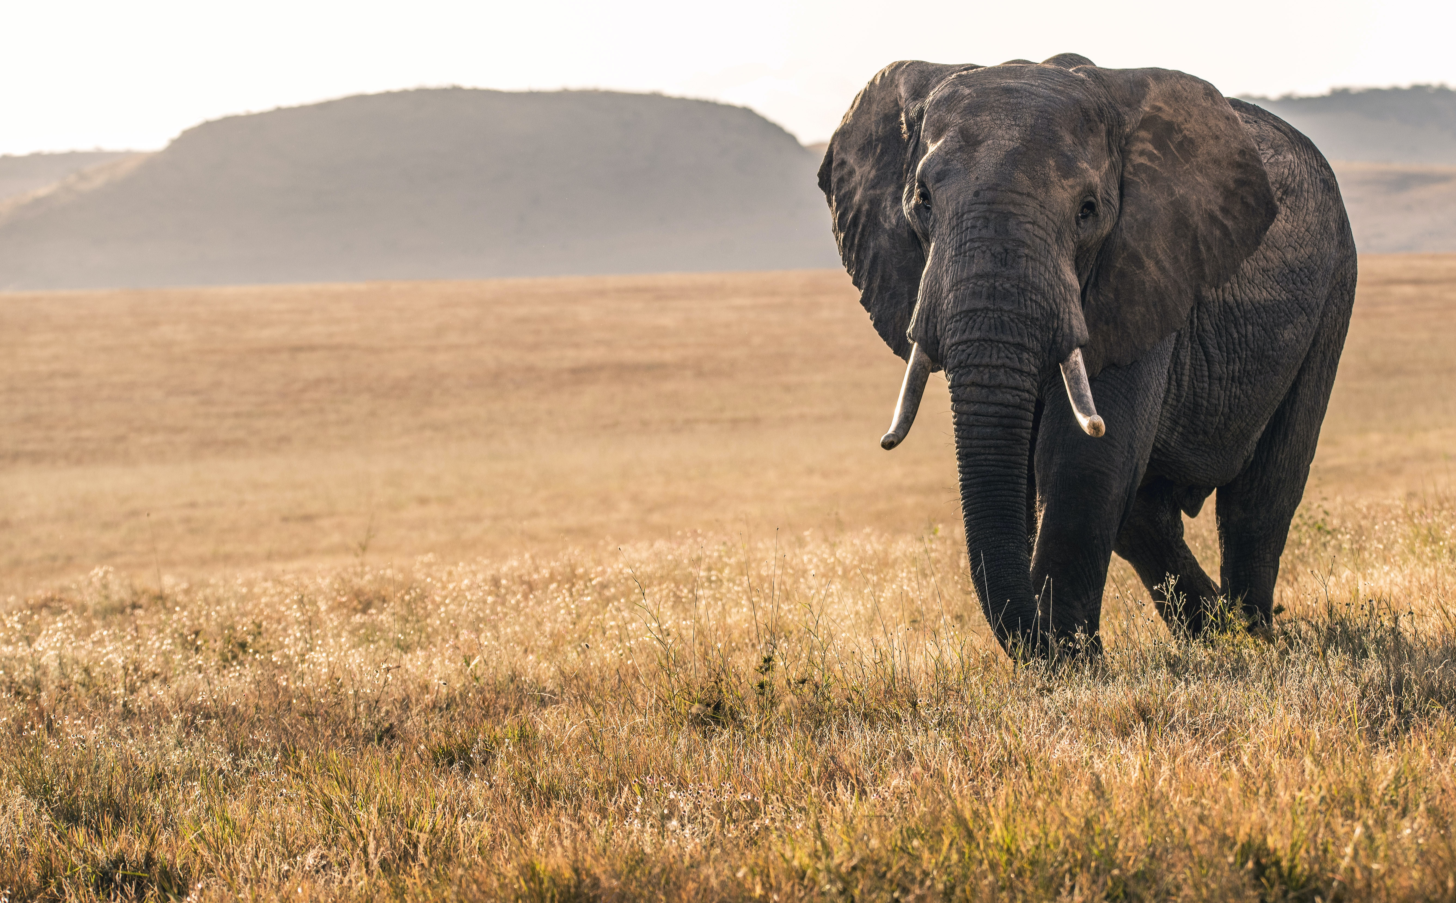

State of Conservation Technology 2020-2022
Explore insights from our multi-year, global, community-sourced assessment of the state of the field.

Slide 2
Technology in 2022 | Proficiency has been increasing in tracking devices, acoustic devices and camera traps
UPDATE!! (line looks better in st)

Slide 3
Performance and potential of technologies 2020
Current overall performance
Capacity to Advance Conservation
GIS/remote sensing
1
1
AI tools
Drones
2
2
eDNA & Genomics
Mobile Apps
3
3
Networked sensors
PA mgmt. tools
4
4
PA mgmt. tools
Bioacoustics
5
5
Drones
Biologgers
6
6
GIS/remote sensing
Camera traps
7
7
Biologgers
AI tools
8
8
Bioacoustics
eDNA & Genomics
9
9
Camera traps
Data mgmt. tools
10
10
Data mgmt. tools
Networked sensors
11
11
Mobile Apps

Slide 4
Performance and potential of technologies 2022
Current overall performance
Capacity to Advance Conservation
GIS/remote sensing
1
1
AI tools
PA mgmt. tools
2
2
Networked sensors
Bioacoustics
3
3
Biologgers
Drones
4
4
GIS/remote sensing
Biologgers
5
5
PA mgmt. tools
Camera traps
6
6
Drones
Data mgmt. tools
7
7
Data mgmt. tools
Mobile Apps
8
8
Bioacoustics
eDNA & Genomics
9
9
Camera traps
AI tools
10
10
eDNA & Genomics
Networked sensors
11
11
Mobile Apps

Slide 5
Technology | Current performance of technologies compared to future potential, 2020
GIS/remote sensing
1
1
AI tools
Drones
2
2
eDNA & Genomics
Mobile Apps
3
3
Networked sensors
PA mgmt. tools
4
4
PA mgmt. tools
Bioacoustics
5
5
Drones
Biologgers
6
6
GIS/remote sensing
Camera traps
7
7
Biologgers
AI tools
8
8
Bioacoustics
eDNA & Genomics
9
9
Camera traps
Data mgmt. tools
10
10
Data mgmt. tools
Networked sensors
11
11
Mobile Apps

Slide 6
Technology | Current performance of technologies compared to future potential, 2022
GIS/remote sensing
1
1
AI tools
PA mgmt. tools
2
2
Networked sensors
Bioacoustics
3
3
Biologgers
Drones
4
4
GIS/remote sensing
Biologgers
5
5
PA mgmt. tools
Camera traps
6
6
Drones
Data mgmt. tools
7
7
Data mgmt. tools
Mobile Apps
8
8
Bioacoustics
eDNA & Genomics
9
9
Camera traps
AI tools
10
10
eDNA & Genomics
Networked sensors
11
11
Mobile Apps

Slide 7
Challenges | Funding remains the main challenge, but duplication of efforts is on a potentially decreasing trend
UPDATE!!
32%
16%
13%
40%
14%
12%
19%
19%
15%
10%
16%
17%
10%
15%
15%
10%
15%
21%

Slide 8
Developing country residents were 1.5x more likely to find maintenance costs, 2.5x more likely to find upfront costs, access to training, advice, mentoring, and 5x more likely to find local access to suppliers and technology a critical user constraint.
Developing country residents were also more likely to find certain developer constraints as critical: 3.5x for sourcing supplies and testing sites, and 2.5x for seed funding.
Female developers were also more likely to face constraints: 2x for user data concerns, 2.5x for continued funding and data access, and 3.5x for testing sites.
UPDATE!!
Challenges | Developing location and gender the most indicative contributing factor to rating

Slide 9
Opportunities | People are becoming more optimistic over the years
UPDATE!!

Slide 10
1
Biodiversity monitoring
2
Species protection
3
Protected area mgmt. and planning
From 2020 to 2022, respondents indicated working on the same conservation challenges
4
Human-wildlife conflict
5
Habitat loss or destruction
6
Public education and outreach

Slide 11
Increasing accessibility and the quickly evolving nature of the field are the main reasons for optimism for most
Opportunities, 2020
Opportunities, 2022
Increasing accessibility
Quickly evolving
Quickly evolving
Increasing accessibility
1
Collaborative culture
1
Growing support
2
2
3
3

Slide 12
1
Collaboration
2
Accessible tools
3
Interoperability of tools
Collaboration and sharing of tools are the main opportunities identified by respondents in both years
4
Data analysis scale
5
Local technology
6
Global data

Slide 13
1
Online sources
2
Individuals
3
Partners
Online sources are the main source of information for respondents, followed by individuals, partners and tech experts
4
Tech experts
5
Academia
6
Government

Slide 14
Members were 1.5x less likely to find access to trainings, and 1.5x less likely to find access to mentors or advice to be constraints as conservation technology end-users.
Members also found it less daunting to match conservation and technical resources: they found this 1.5x less likely to be a challenge.
Interestingly, WILDLABS members were 2x more likely to identify scaling technology and tools sustainably as a challenge than non-members.
WILDLABS | Membership had a measurable positive impact

